Slide 1
EXAM SEATING ARRANGEMENT
Submitted in the partial fulfillment for the award of the degree of
BACHELOR OF ENGINEERING
IN
COMPUTER SCIENECE AND ENGINEERING
Submitted by:
PARAS 18BCS3849
HARSHIL DHIMAN 18BCS3843
DEVVRAT DANU 18BCS3857
VANSHIKA SOOD 18BCS3799
Under the Supervision of:
JYOTI PRUTHI
Department of AIT-CSE
DISCOVER . LEARN . EMPOWER

Slide 2
Outline
Introduction to Project
Problem Formulation
Objectives of the work
Methodology used
Results and Outputs
Conclusion
Future Scope
References

Slide 3
Introduction to Project
This project provides a way to allocate exam hall for each students without any clash.
Exam Seating Arrangement is specifically design for automation of exam system.
This system deals with Seating Arrangement process of exam online instead manually.
The “Exam Seating Arrangement” system has been developed to override the problems prevailing in the practicing manual system.
The system is supported to eliminate and in some cases reduce the hardships faced by this existing system.

Slide 4
Every educational institution has examination held at particular intervals. A software application is necessary for exam seating arrangement during examination process. It can help the student to find their respective examination hall and seat allotted to them. The purpose for developing this system is to computerized the manual exam seat allocation to lighten the burden on the staff. Another purpose of developing this software is to help student guide to the respective examination hall during exam.

Slide 5
Problem Formulation
Most of the institutions are becoming unwilling to centralize examination system day by day. One of the major causes is that with the increasing number of students, courses and department, it becomes almost unmanageable to allocate proper exam seats.
It is quite difficult to properly allocate the seats among a large number of students whenever the students are different subjects.

Slide 6
Objectives of the Work
To reduce the paper work and storage area.
To compute the performance of the system for minimum resources usage.
To minimize the limitation and problems of the existing system.
To reduce the man power.
To computerize the traditional way of conducting the exams.

Slide 7
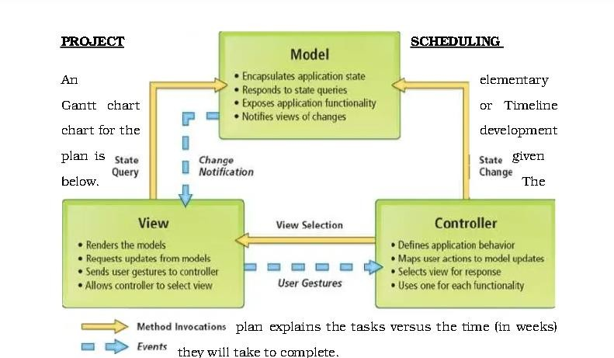
Methodology used

Slide 8
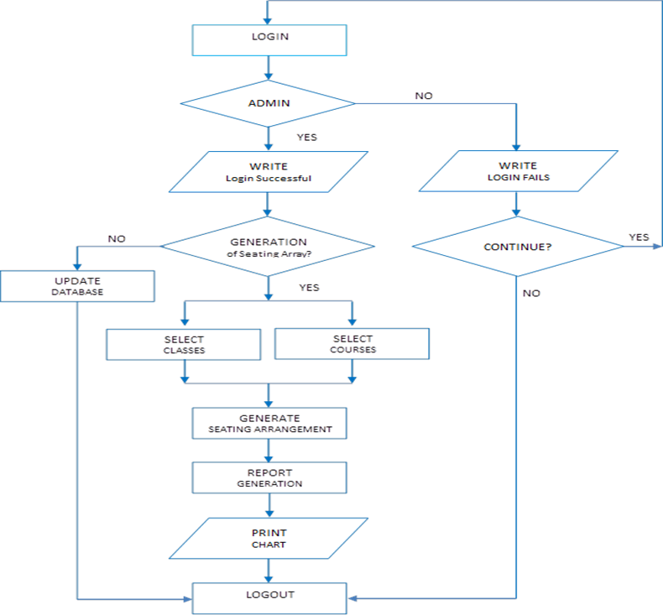

Slide 9
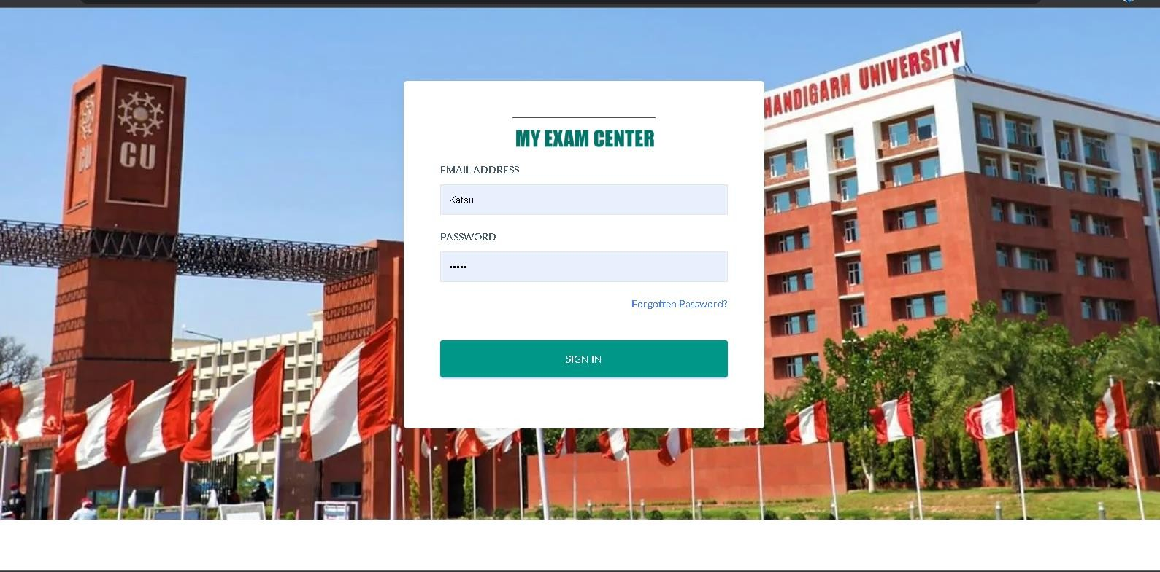
Results and Outputs

Slide 10
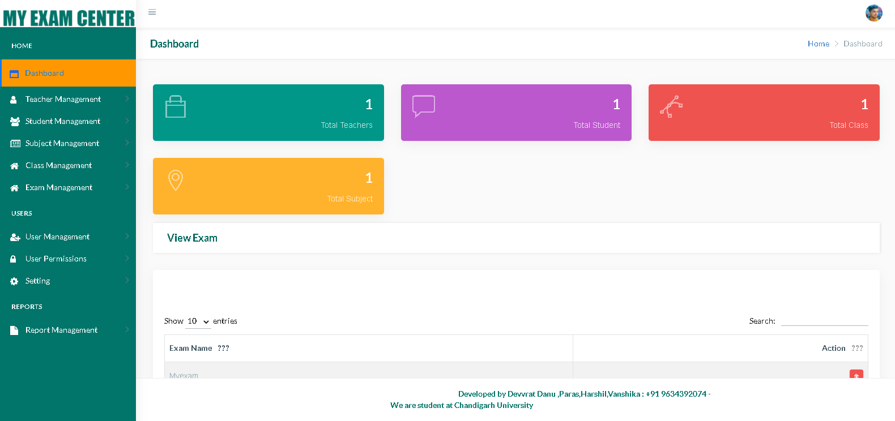

Slide 11
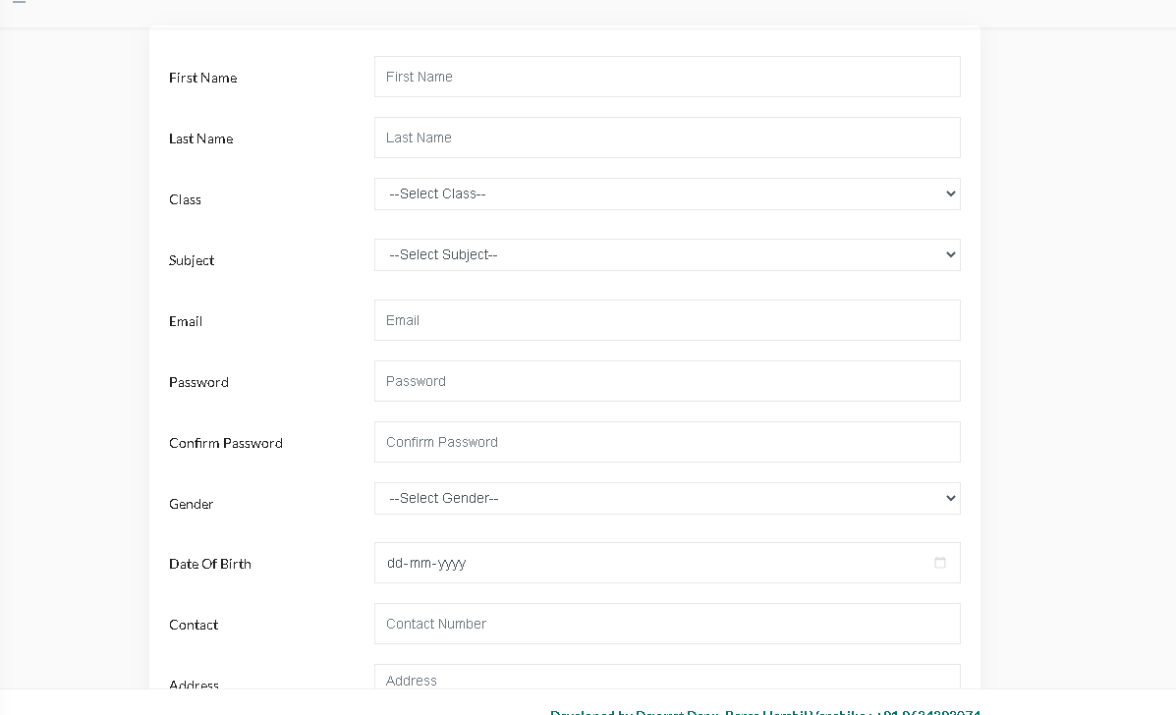
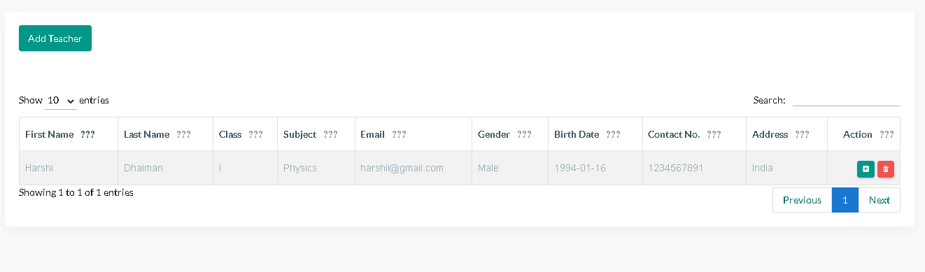

Slide 12
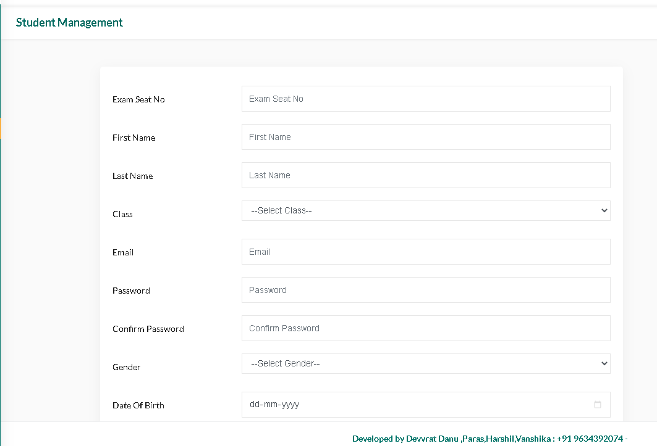
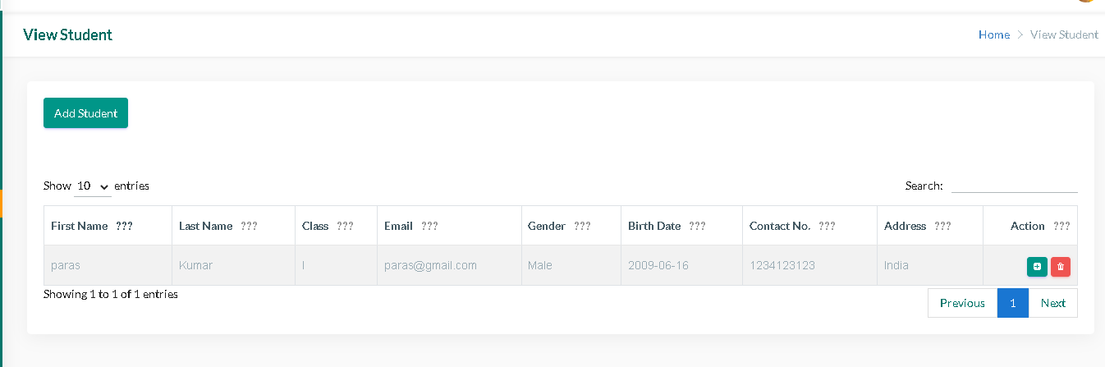

Slide 13
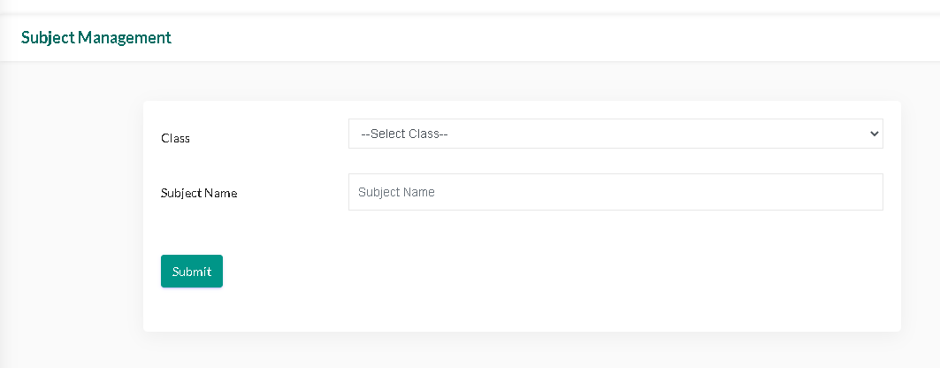
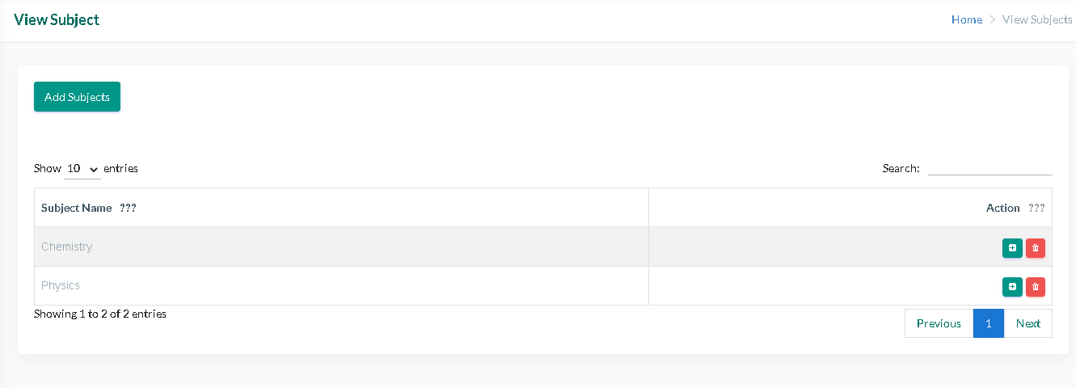

Slide 14
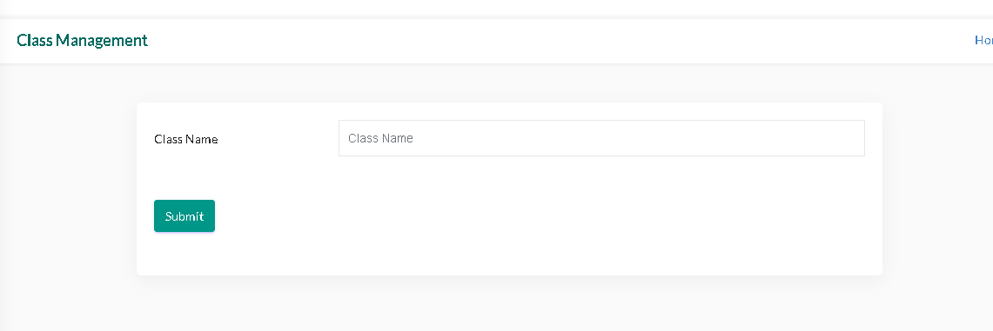
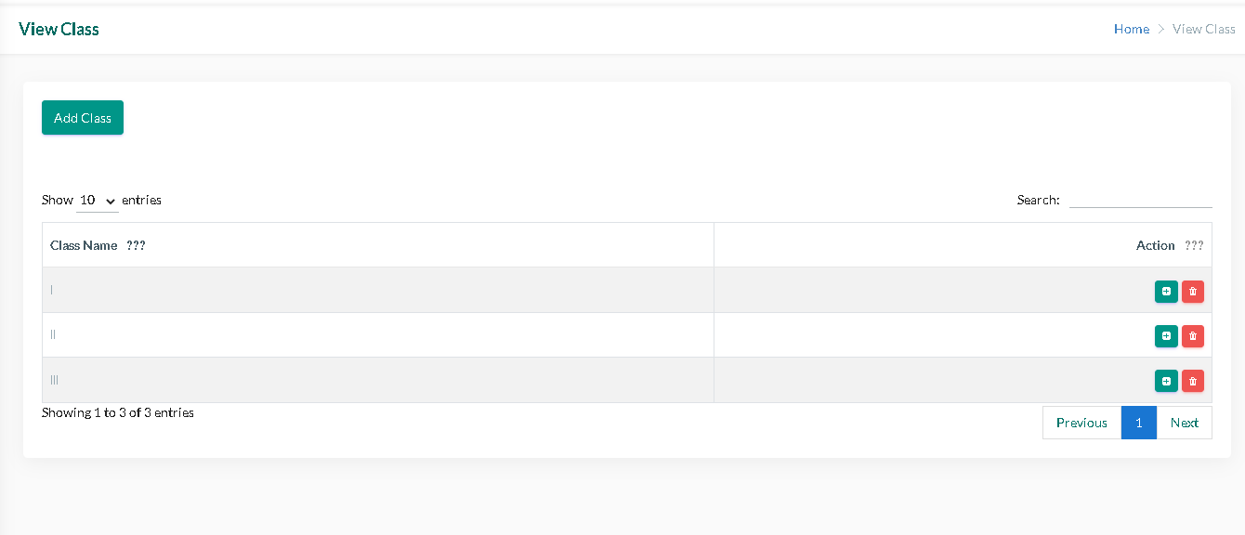

Slide 15
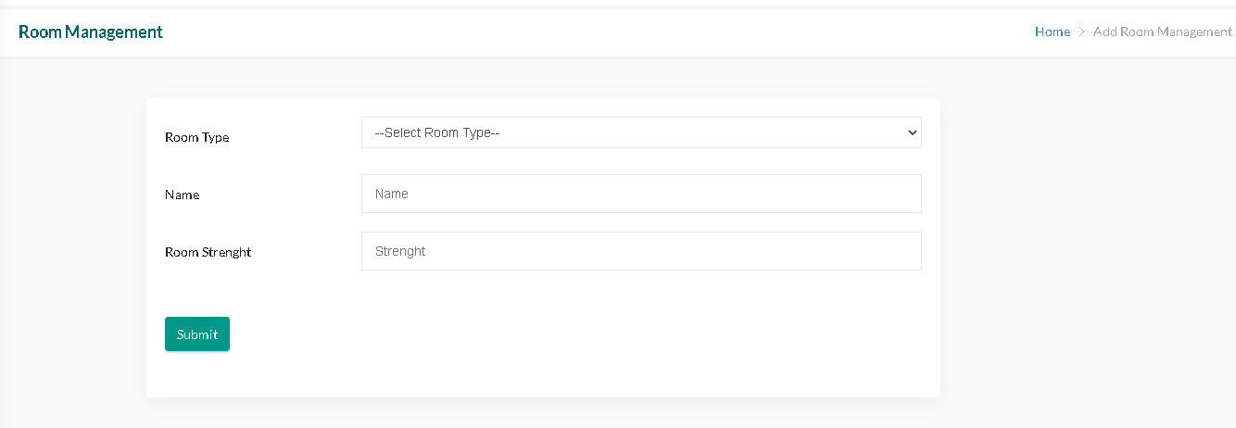
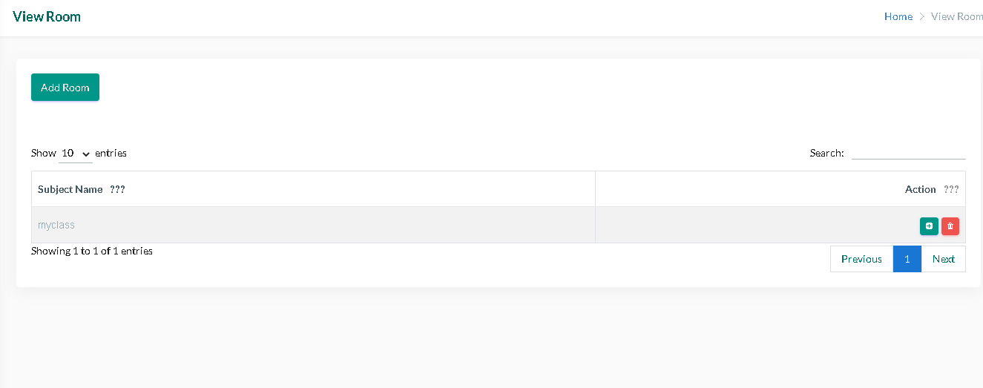

Slide 16
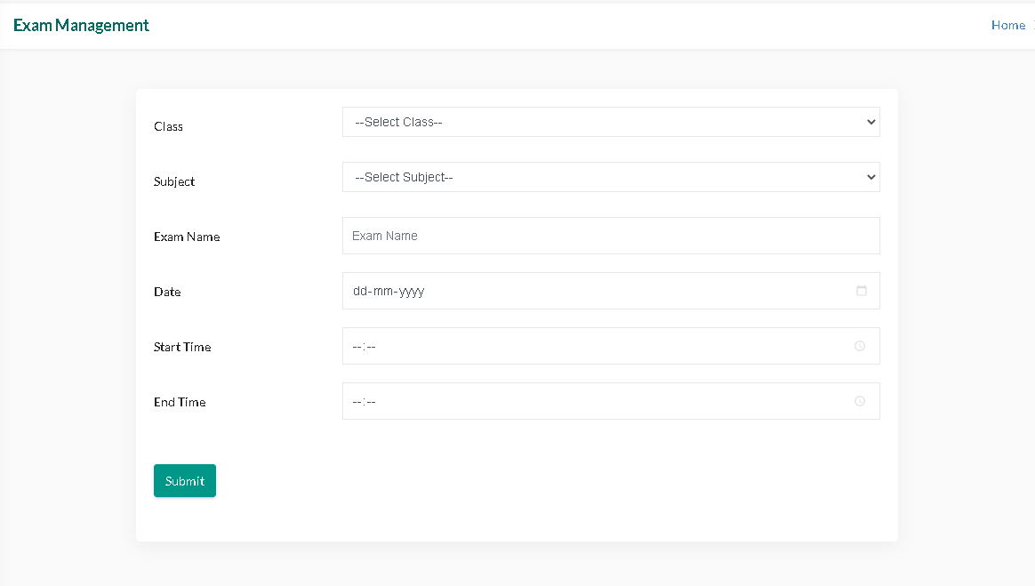
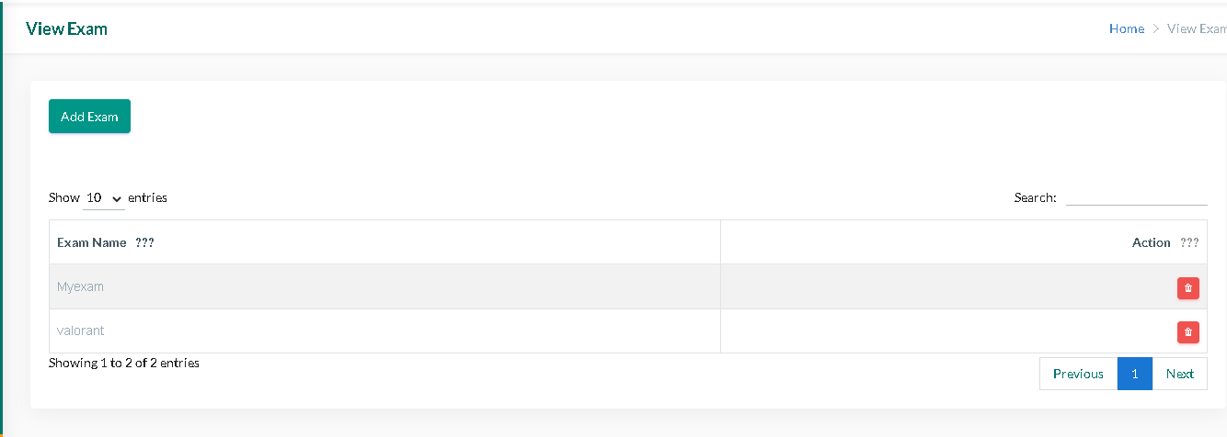

Slide 17
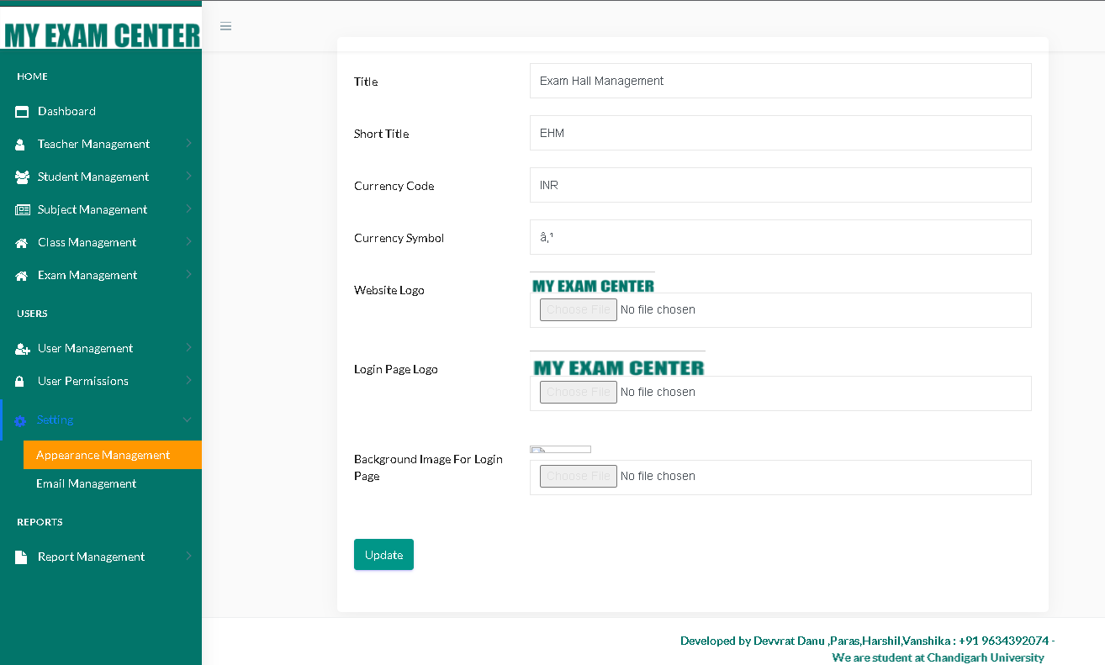

Slide 18
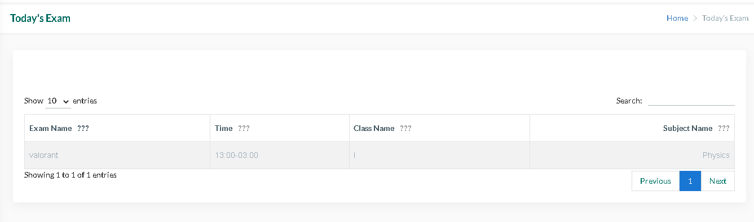
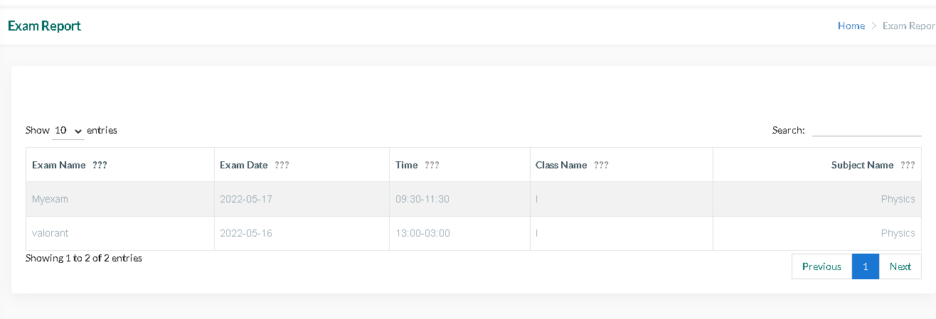

Slide 19
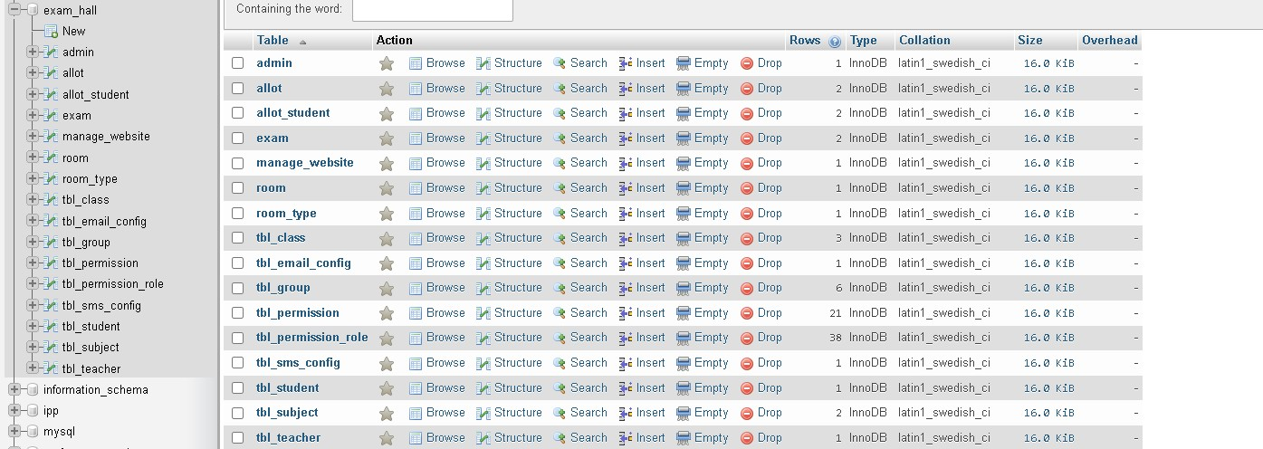

Slide 20
Conclusion
This system avoids the manual work and the problems concern with it. The system was designed in such a way that future modification can be done easily. The following conclusion can be deduced from the development of the project :-
Automation of entire system improves the efficiency.
It provides a friendly graphical user interface which proves to be best.
It gives appropriate access to authorized users depending on their permissions.
The system has adequate scope for modification in future if it is necessary.

Slide 21
Future Scope
In a nutshell it can be summarized that the future scope of the project :-
The randomizing of students roll numbers is going to be effective.
System can be developed which can take backup automatically asa soon as data is generated.
With the help of 3D graphics, it will shows the class architecture more efficiently.
We can create mobile application.

Slide 22
References
Anyanwu G. (2014). Success Above Average: Real Life Lessons for Parents and their Children, Author House, UK.
Adetona S.O., & Akinade A. (2016). Curtailing Examination Malpractice In Citadel of Learning: Technological Options, Security and Safety Reviews, 1(1): 64-68.
Hinman, L.M. (2000). Approaches to Cheating and Plagiarism, [Online].
Onyechere I. (2004). Cheating: A World-wide problem, In “comes at least 33 ways” retrieved from AllAfrica.com
Underwood J. & Sarbo, A. (2004). Academic Offences and E-learning: Individual Propensities in Cheating, British Journal of Educational Technology, 34: 467 – 478.
Adetona S., Hassan, E., Salawu R. and Omolola S., “The Development
of a Web-based Application of Examination Seating Arrangement for
Student”, ABUAD Journal of Engineering Research and Development, (1) (2020), 23-33.

